Slide 1

HRH General Safety

Slide 2

Potential Hazards
Physical injuries
Equipment issues
Emergencies
Hazardous materials
Accidents

Slide 3
Back Pain – Lift Properly
Position feet shoulder width apart
Keep knees bent, back aligned
Hold object close to you
Use leg muscles to stand up

Slide 4
Volunteers are NOT to lift patients for any reason

Slide 5
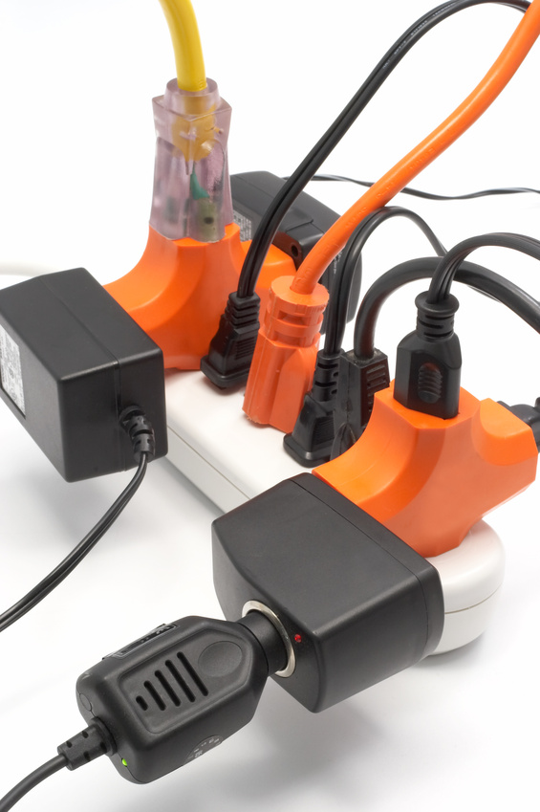
Equipment
Keep equipment clutter to a minimum
Report faulty equipment
Safe Medical Devices Act requires any death or serious injury be reported

Slide 6
Emergencies – HRH Safety Protocol
Code Black – tornado sighting
Code Red – fire
Code Amber – missing person
Code One – aggressive behavior
Code Blue – medical emergency, not breathing, no pulse
FASTeam – medical emergency with non code situation
Emergency disaster – internal or external
Severe weather or tornado watch

Slide 7

Fire Safety
Rescue
Alarm
Confine
Extinguish
Respond with RACE
Use PASS technique with extinguishers
Pull
Aim
Squeeze
Sweep

Slide 8
Workplace Violence
Any threatening behavior occurring in work related setting
Report the 4 Ws
  Who was it – any witnesses?
  What exactly happened – just the facts
  When did incident occur
  Where did incident happen

Slide 9
Hazardous Materials
OSHA standards protect people from exposure
Material Safety Data Sheets (MSDS) provide information on all chemicals and are kept electronically

Slide 10

MSDS Sheets Contain
General information
Hazardous ingredients
Physical data
Fire & explosive hazard data
Health hazard data
Reactivity data
Spill, leak & disposal procedures
Control measures
Special precautions

Slide 11
Hazardous Chemical Information
Types
  Liquid
  Solid
  Gas
Exposure causes
  Rash
  Burns
  Nausea
  Headache
  Dizziness

Slide 12

General Safety Guidelines
Always do what is right the right way the first time
Pay attention to your surroundings
Identify/report all situations which put others at risk and take responsibility to resolve the risk if able
Take responsibility for your own safety.
  For example, always wear the appropriate Personal Protective Equipment (PPE)

Slide 13

General Safety Guidelines (continued)
Report any accident to your supervisor immediately
Make sure you can operate equipment safely
Follow rules, comply with regulations, and maintain a consistent level of readiness

Slide 14
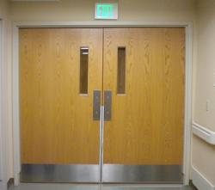
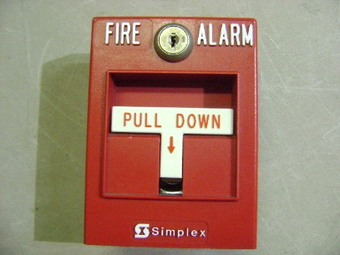
Common Safety Situations
Doors
  Allow them to remain closed or open as designed
    Do not prop them open
    Do not block the path to an exit door
Fire Alarm Pull Stations and Fire Extinguishers
    Must be accessible at all times
    The area above, below, and beside pull stations must be clear

Slide 15
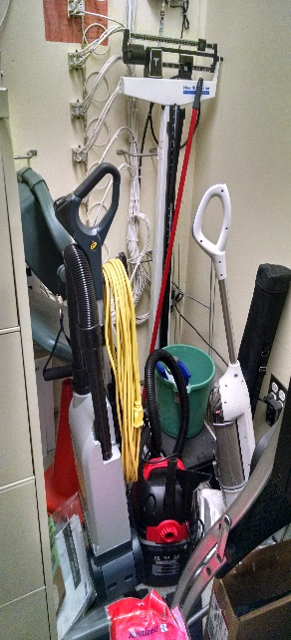

Common Safety Situations
General Items
  No space heaters
  Do not connect power strip/surge protectors together
  Use only approved extension cords
General Clutter
  Hallways, workspaces, etc. must be kept neat and orderly
  In use items are acceptable in hallways as long as they will be used within 30 minutes
No!!
No!!

Slide 16

Ethics
Notes:
16

Slide 17
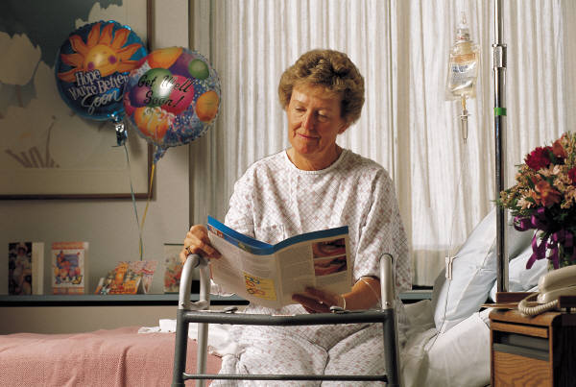
Patient Rights
Advance directives
Living will
Durable power of attorney

Slide 18
Living Will – Form of advance directive
Documents patient treatment decisions in case of terminal illness
Durable Power of Attorney – Form of advance directive
Allows patient to appoint someone to make treatment decisions
Advance Directive – Legal document stating
Patient treatment preference
What types of treatment patient will accept
Who may make treatment decisions
Notes:
18

Slide 19

Healthcare Laws
HIPAA – Health Insurance Portability & Accountability Act
  Privacy rule
  Ensures personal medical information is protected
  Gives patient rights regarding health information
Notes:
19

Slide 20
Protected Health Information (PHI)
Patient information
  Patient name
  Address
  Zip code
  Social security number
  Physician’s personal notes
  Billing information
Confidential information
  Details about illness or condition
  Information about treatment
  Healthcare provider notes
  Conversations between patient & healthcare provider
Notes:
20

Slide 21
HIPAA Law Requires
Patients be allowed to inspect & copy their medical record
Designation of a Privacy Officer
Development of Notice of Privacy Practices
The development of policies & safeguards in place to protect PHI & limit exposures
A process for filing & resolving formal complaints
Notes:
21

Slide 22

Volunteer/Associate Responsibilities
NEVER discuss patient information in public areas with others
DO NOT inquire about patients, friends, co-workers or acquaintances
If you overhear or witness a breech, notify your supervisor immediately
DO NOT open/read a patient’s chart or medical record if you are not providing direct care
Notes:
22

Slide 23
Violation of patient confidentiality is cause for disciplinary action up to and including termination

Slide 24
Corporate Compliance
Definition
  A formal program specifying HRH’s policies, procedures, and actions to help prevent and detect violations of the law and regulations
Four goals of a compliance program
  Education staff
  Encourages staff to seek advice and conduct activities according to law
  Enables organizations to investigate, prevent, and deter criminal activity
  Enforces all employees comply with internal policies and procedures
Notes:
24

Slide 25
Seven Elements of a Compliance Program
1
Policy
2
Oversight
3
Education
4
Monitoring
5
Internal Review
6
Investigation/ Remediation
7
Discipline
Corporate Compliance Officer = Lisa Imlay, Executive Director of Quality, Safety, & Compliance
Direct any questions or concerns to her
Notes:
25

Slide 26
HRH has “zero tolerance” (immediate termination) for volunteers or associates willfully & knowingly breaking laws and regulations while performing their job.

Slide 27
Infection Control Issues
Notes:
27

Slide 28

Infection Control Topics
Transmission precautions
Standard precautions
OSHA Categories
Sharps Injuries
Immunizations

Slide 29
Four Methods of Infection
Airborne
Passes through air
Contact
Passes by direct contact
Bloodborne
Passes through blood to blood contact
Droplet
Passes through inhaled droplets
Measles
Varicella
Tuberculosis
Herpes
Staph infections
Pneumonia
Menningitis
Mumps
Hepatitis B & C
HIV
Notes:
29

Slide 30
Tuberculosis
Resurfaced in 1980’s
High risk populations
  People from other countries with high prevalence
  Low income populations
  Homeless populations
  Intravenous drug users
  Populations found in nursing homes & prisons
Notes:
30

Slide 31
Tuberculosis disease
Infection – exposed to TB
  Body’s natural immune system strong enough to keep organism contained and under control
Disease – active TB
  Body’s immune system no longer controls organism and disease becomes active
Notes:
31

Slide 32
TB Transmission
Coughing
Singing
Talking
Sneezing
Notes:
32

Slide 33
TB Controls
Administrative
  Policies
  Prescreening protocol
  Annual testing
Engineering
  Mechanisms to minimize spread
Individual
  Personal protective equipment
Notes:
33

Slide 34
Volunteers are not to enter any isolation room including AFB isolation rooms

Slide 35
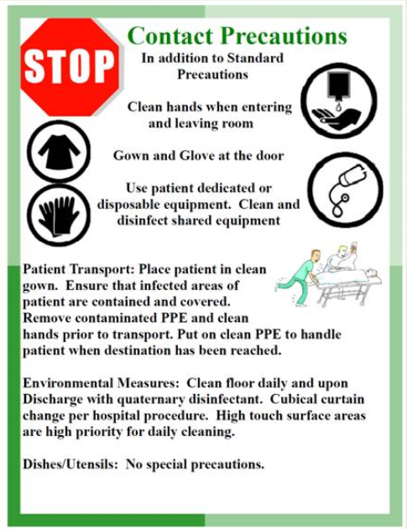
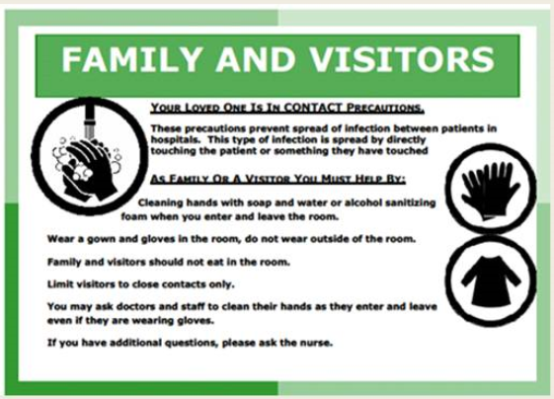
Transmission-based Precautions (isolation)
Used in addition to Standard Precautions
Isolation signs on doors with precaution alerts
  Airborne
  Contact
  Droplet
  Neutropenic
Personal Protective Equipment instructions are on the backs of the signs
Notes:
35

Slide 36
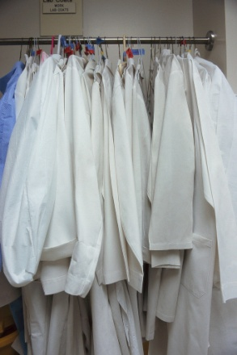

Standard Precautions-personal protection
The single most effective method of preventing disease transmission is
  HAND HYGIENE
  Wash your hands regularly and often
  May use alcohol rub if there is no visible soiling
Use PPE (personal protective equipment)
  Gloves Protective clothing Face protection
  Goggles
  Face shield
  Respiratory mask
Notes:
36

Slide 37

Proper Hand Hygiene
Keep finger nails less than ¼ in. long and in good repair
Polish is allowed if kept in good repair and no chips
Use warm water for 15-30 seconds
Use paper towel to turn off water
Prevent chapping or cracking
  Thoroughly dry after washing
  Use lotion often
  Wear gloves outside in cold weather
Notes:
37

Slide 38
OSHA Categories
Category I
duties routinely involve potential for contact with blood/body fluids
Category II
duties normally do not involve contact with blood/body fluid, but potential may exist
Category III
duties with no exposure to blood/body fluids
Notes:
38

Slide 39
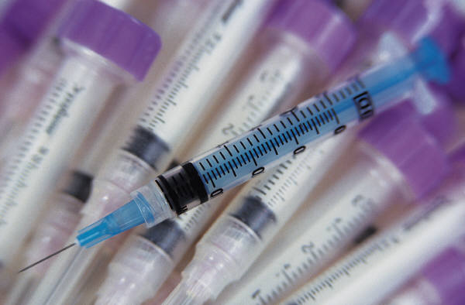
Sharp/Needle Stick Injury
Volunteers are not to change sharps containers or handle needles/sharp objects
Should an injury occur - WIN
  Wash with soap and water, rinse eyes using nearest eye wash station
  Identify the source of exposure
  Notify your supervisor immediately
  Post exposure protocol is available
Notes:
39

Slide 40

Immunizations
Being up to date on immunizations is required for all volunteers
Associate health department will screen and update if needed at no charge
Annual mandatory flu vaccination for all associates and volunteers
Hepatitis B vaccine offered to volunteers in OSHA Categories I and II
Notes:
40

Slide 41

Patient Safety
Notes:
41

Slide 42

Fall Reduction
Healthcare providers assess patients risk of falls and document accordingly
Important to use proper equipment (ie: gait belt, slide sheets) before moving patients to prevent falls

Slide 43
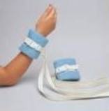
Patient Restraints
The use of restraints should be used minimally
Attempt other alternatives before putting a patient in restraints, ie: move closer to the nurses station, distraction measures, sitter
If restraints are necessary, you must use an approved restraint device, such as soft wrist restraints
Qualified staff must monitor patients in restraints
Different types of restraints use: soft wrist restraints, leather restraints, seclusion, 4 bedrails, & chemical (medication)
*** Volunteers are exempt from this procedure

Slide 44
Acute Coronary Syndrome
Notes:
44

Slide 45


Slide 46
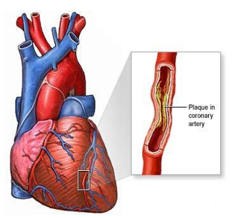
What is Coronary Artery Disease (CAD)?
CAD is a condition in which plaque builds up inside the arteries of the heart.
Plaque is made up of fat, cholesterol, calcium, and other substances found in the blood. These can cause blockages in the arteries.
Symptoms usually only occur when the blockage is 75% or more.

Slide 47
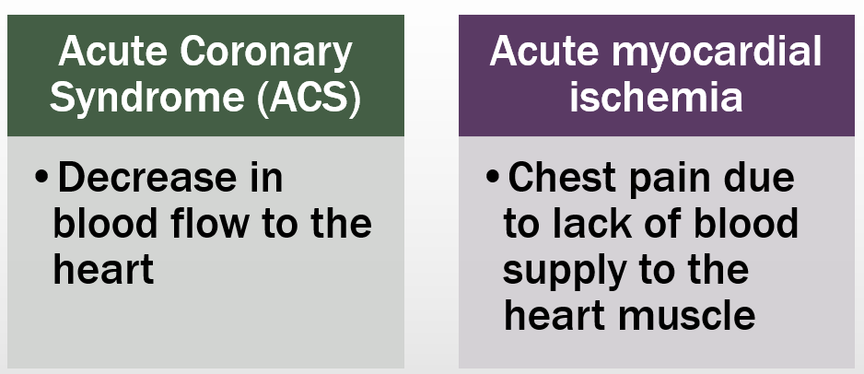
What is Acute Coronary Syndrome?
HRH’s ACS program is accredited through the
American College of Cardiology Accreditation Services

Slide 48
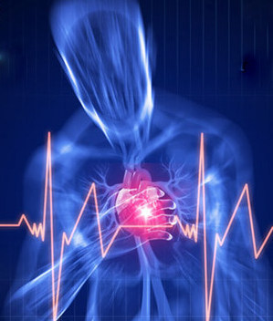
Heart Attack!
Occurs when a blood clot blocks the flow of blood through an artery in the heart
Blocked blood flow to your heart can damage or destroy a part of the heart muscle

Slide 49
Risk Factors for Heart Disease
Tobacco use
Peripheral Vascular Disease
Family history of heart disease
Age
  >45 for men
  >55 for women
High Blood Pressure
Diabetes
High Cholesterol
Poor nutrition (diet high in fat and cholesterol)
Lack of physical activity

Slide 50
Age & Gender Differences
44% of women die as a result of their first heart attack compared to 27% of men
Every 10 years of age increases risk of death from ACS by 75%
Diseases such as heart failure and diabetes mask signs and symptoms of ACS
Mental impairment of the elderly prevents them from recognizing the signs and symptoms of ACS

Slide 51
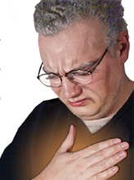
Typical Symptoms of ACS
Chest Pain or Discomfort
  - “Pressure”
  - “Squeezing”
  - “Aching”
  - “Burning”
  - “Fullness”
  - “Suffocation” sensation
  - “The worst they’ve ever had”

Slide 52

Atypical Symptoms of ACS
Neck, Back, Jaw, Shoulder, or Arm discomfort
Shortness of Breath
Nausea
Sweating
Lightheadedness / Dizziness
Weakness / Fatigue
Feeling of doom
Sharp or “knife-like” pain with coughing/breathing
Pain that spreads above jawbone or into lower body
Those mostly likely to have these different symptoms are diabetics, women, and the elderly.

Slide 53

Now that I know!
What do I do??

Slide 54
Call for Help Quickly
Unresponsive
Call 4-4444
Report location
Responsive
Ask person to sit or lie down
Report location
Call 4-4444
Call for Adult Cardiac FASTeam
Call for Code Blue
Begin CPR if certified
Stay with person until help arrives

Slide 55
Acute Stroke
Notes:
55

Slide 56
What do I need to know?
3rd leading cause of death in the United States
Stroke is the leading cause of adult disability
African Americans have nearly double the risk of stroke compared to Caucasians
Approximately 80% of strokes are preventable
HRH’s stroke program is accredited through
Healthcare Facilities Accreditation Program (HFAP)

Slide 57
Stroke (brain attack) Facts
2,000,000 brain cells die every minute during a stroke
Occurs when a blood clot blocks an artery or a blood vessel breaks in the brain causing a decrease in oxygen to the brain
When brain cells die during a stroke, the ability to control speech, movement, and memory are lost
The effects of a stroke afterwards depends on where it occurred in the brain and how much damage was done

Slide 58
Risk Factors
Which can be changed:
High blood pressure
Tobacco abuse
Alcohol/drug use
High cholesterol/diet
Diabetes
Lack of exercise
Weight management
Which cannot be changed:
Age
Gender
Race
Ethnicity
Family history

Slide 59
Stroke Symptoms
Sudden weakness or numbness of face, arm, leg (especially on one side)
Sudden confusion, trouble speaking or understanding
Sudden trouble seeing out of one or both eyes
Sudden headache with no known cause
Sudden trouble with walking, balance or coordination
Sudden dizziness

Slide 60
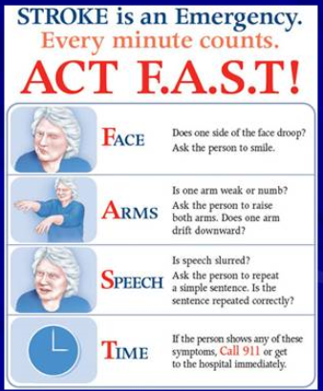
What to do?
Act F.A.S.T.!!
Anyone can perform the F.A.S.T response assessment
Document the time the symptoms started
Flyers are posted within the hospital
Early treatment for a stroke increases survival
Call for help by dialing 4-4444 (in the hospital) or 911 (off–site locations)

Slide 61
Patient Care
Notes:
61

Slide 62
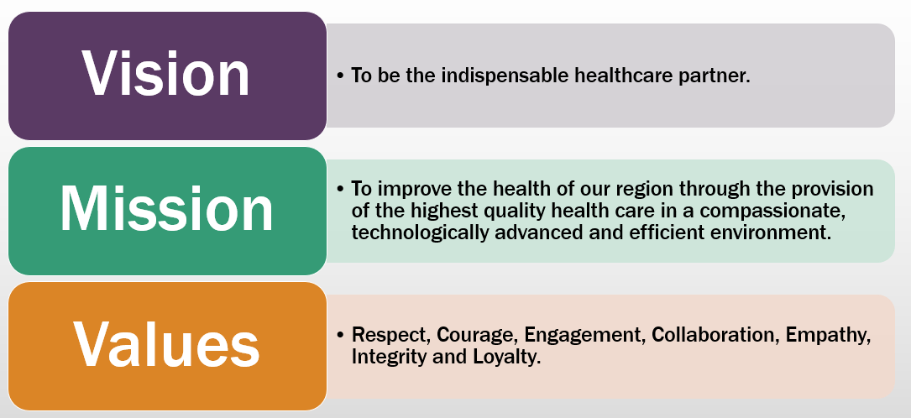
Patient Care is the Driving Force Behind HRH’s Shared Vision, Mission, and Values

Slide 63
Patient Rights
Patients have the right to receive considerate, respectful care & privacy.
Knock & wait before entering room
Respect patient & family wishes
Protect patient privacy and integrity
Respond to patients in a polite manner
Notes:
63

Slide 64
Introduce Yourself-A Service Excellence Tool
Using the H-R-H Acronym
Hello – Focus on eye contact, tone of voice to match the situation/patient
Reason for visit – Provide explanation/expected time of procedure/pain expectations, duration & side effects
Help – How can I help? What happens next? What kind of follow up should be expected?
Notes:
64

Slide 65
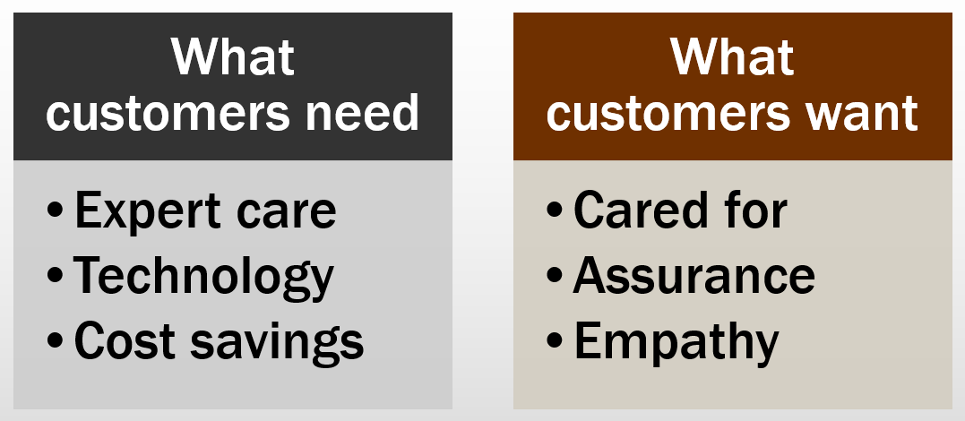
Patient and Family Centered Care

Slide 66
Quality Assessment/ Performance Improvement
Notes:
66

Slide 67
Quality Assessment (QA)/Performance Improvement (PI)
Definitions:
  QA: Looking for process improvement opportunities & meaningful solutions to meet the needs of our customers
  PI: Method for making a difference and tracking that difference
  HRH uses QA/PI process to:
    Improve quality and safety
    Increase customer satisfaction
    Create work environments that attract and retain staff
    Save time and money
Notes:
67

Slide 68
Performance Improvement Process
  Identifies customers (ie: patients & associates)
  Reviews current outcomes & sets a baseline
  Examines the current processes to identify problem areas
  Identifies solutions for each recognized problem
  Implements solutions to promote process improvement
  Evaluates the PI work by comparing improved outcomes

Slide 69
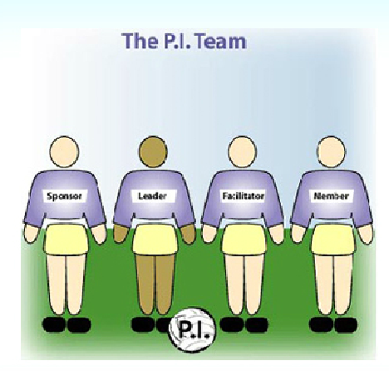
Members of the PI Team
Senior Management
  Supports the project
  Ensures the team has what they need
Team leader
  Is in charge of the team
  Ensures the team meets its goals
Team facilitator (Emily Edwards-Lean Leader/PI Manager)
  Helps the team work through the PI process
  Keeps the meetings focused & productive
  **Lean is a systematic method for the elimination of waste
Team members
  Actively participate in every team meeting
  Complete outside assignments & report findings
  Use data to analyze the process
  Determine changes & solutions

Slide 70
Questions
Talk with your director or manager of your department or
Ask a Human Resources representative or
Talk to an Educational Services representative for assistance

